Slide 1

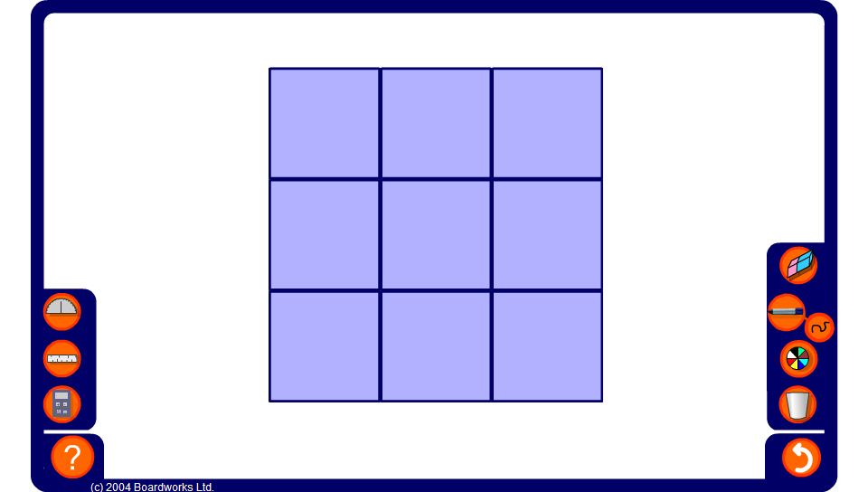


Magic Square
Notes:
Explain that in a magic square, each row, column and diagonal adds up to the same number.
Start by finding the ‘magic total’, that is the sum of each row, column and diagonal.
Ask pupils to find the values of the integers in the empty cells.
Click on the empty cells to reveal the solution to the magic square. Click on the reset button for a new puzzle.

